Slide 1
Biomolecules
Book Notes pages 59-63

Slide 2
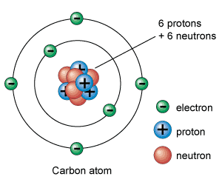
Biomolecules
All biomolecules contain the element:
carbon

Slide 3
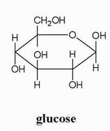
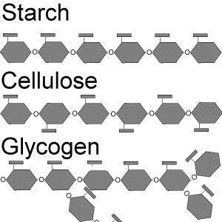
Carbohydrates:
What do they do for our bodies?
Energy, Structure, Cell Identification
Where do we find them in our foods?
Fruit, Vegetables, Pasta, Bread, Soft Drinks
Basic Shape:
C,H,O (1:2:1); Ring Shape
Repeating Molecule:
Monosaccharide (sugar)
Example: Glucose (C₆H₁₂O₆)

Slide 4
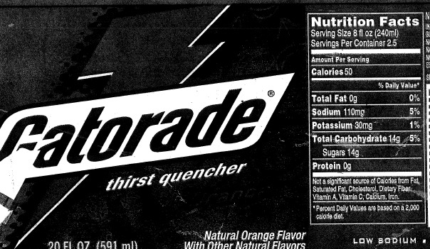
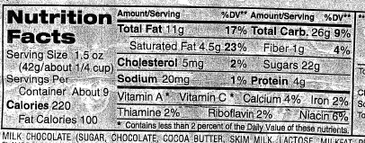
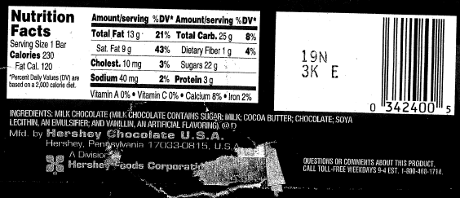
carbohydrates

Slide 5
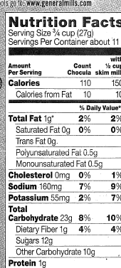
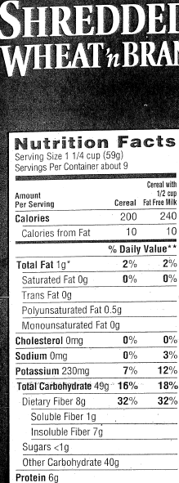
carbohydrates

Slide 6
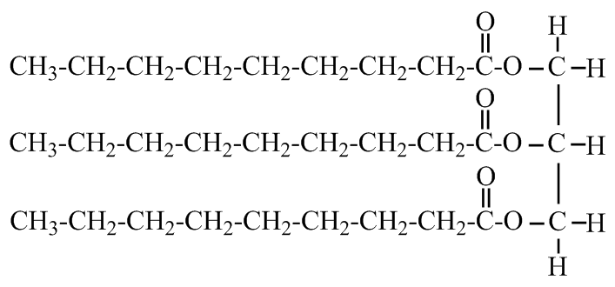
Lipids:
What do they do for our bodies?
Storing Energy, Water Movement
Where do we find them in our foods?
Plant Oils, Animal Fats
Basic Shape:
2 or 3 long chains
Repeating Molecule:
Fatty Acid
Example: Triglyceride (C₅₅H₉₈O₆)

Slide 7
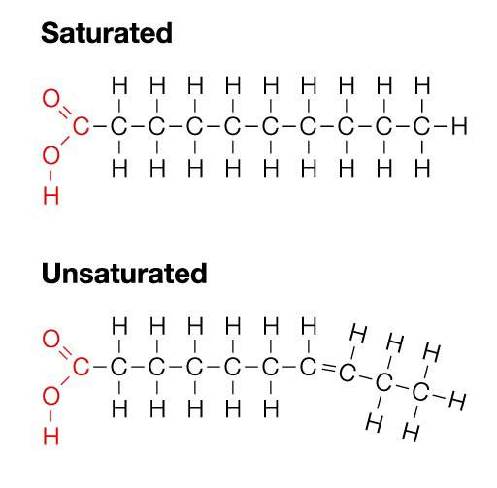
Saturated Vs. Unsaturated
Saturated: Animal fat, solid at room temperature, “toothpicks” can cause heart disease
Unsaturated: Plant oils, liquid at room temperature, healthier for you

Slide 8
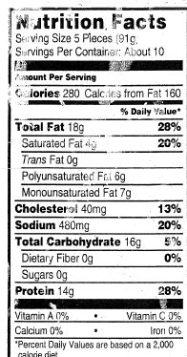
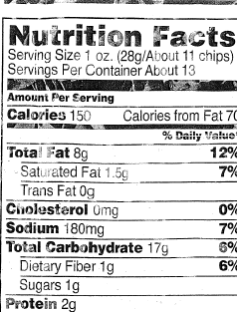
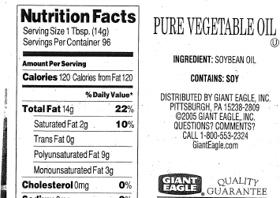
lipids

Slide 9
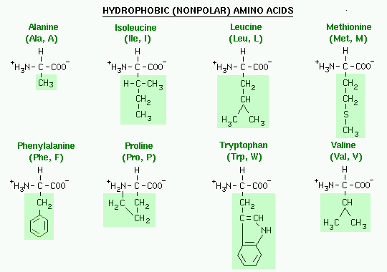
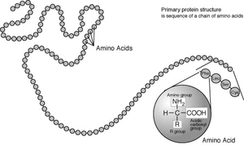
Proteins
What do they do for our bodies?
Build, Repair, Cell communication
Where do we find them in our foods?
Lean Meat, Beans, Nuts, Dairy
Basic Shape:
Beaded Necklace
Repeating Molecule:
Amino Acid
Example: Collagen (C₅₉₇₈H₉₂₈₅N₁₈₃₅O₁₉₄₁S₃₁)

Slide 10
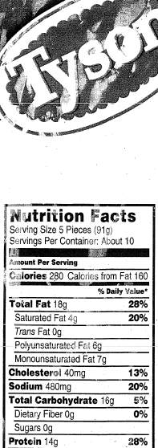
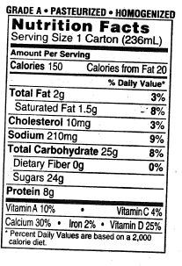
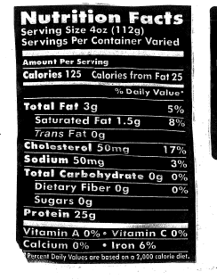
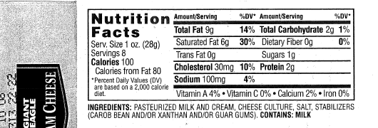
protein

Slide 11
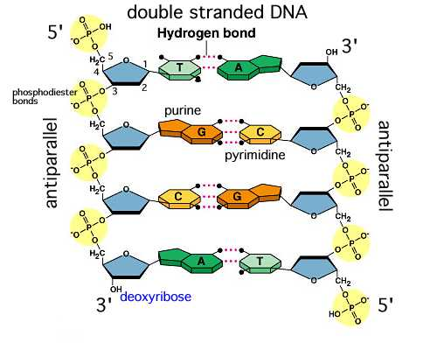
Nucleic Acids
What do they do for our bodies?
Contain genetic information (DNA)
Where do we find them?
Biological parents, Every cell has a copy

Slide 12
Review
Use the information you have written above to answer the following questions.
The four major classes of organic compounds are:
Carbohydrates, lipids, proteins and nucleic acids
Fats are lipids that store
Energy
What roles do proteins play in organisms?
Build and Repair

